Slide 1
RELEASE 3 DEMO
Rick Carbone, Laz Bradley, & Wil Mullin
Team 10 - Unique User Authentication via Behavioral Metrics

Slide 2
Work Since Release 2
Since release 2, we have completed our preliminary research, finished designing our experiments, and have begun collecting data from our experiments.
We have created the testing environment for our experiment in the form of a website that tracks user behavior
We are now ready to collect data and form conclusions for our experiment, we are collecting:
Heatmaps
Movements
Keyboard strokes
Typing Speed

Slide 3
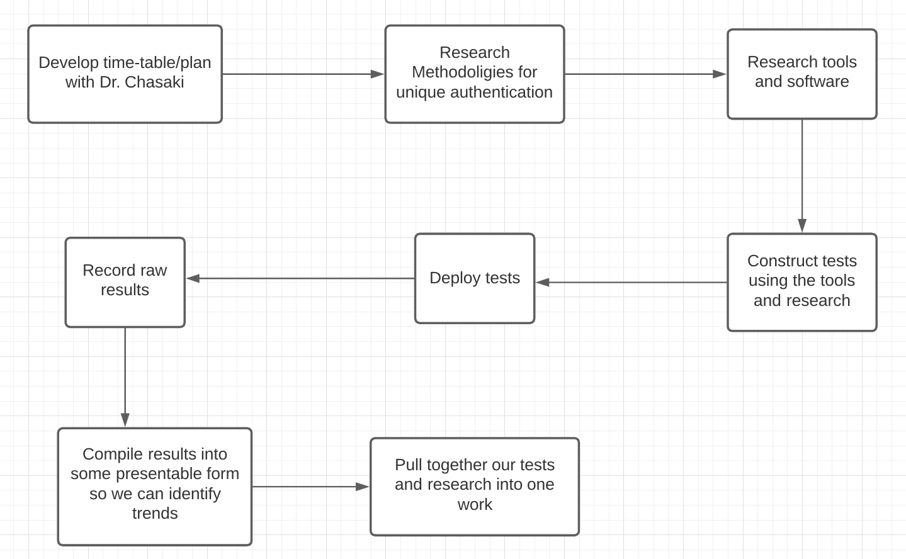
Revisiting Project Roadmap

Slide 4
Experiments
We needed software that we could use to obtain behavioral metrics on computer users, and we eventually settled on using a software called Hotjar in conjunction with a website environment designed in WordPress.
The basis of the experiment is that we are going to give users a few short tasks to do multiple times in our website environment. We are going to collect metrics on their behavior during each repetition, and analyse the data to see how consistent user input is, how much regular behavior tends to deviate from the norm, and how reliable these metrics are for identifying a specific user’s behavior.

Slide 5


HotJar and Our Testing Environment
Login and Dashboard created with WordPress CMS
Hotjar is the mouse tracking tool we will be using and it was installed as a plugin on the website
The login page is used in order to mimic what users will do when they are logging in to an account; multiple logins will be required from each user in order to see if there any unique patterns that can be identified from users (both keyboard and mouse)
The dashboard is used in order to mimic what users will do in a “mock dashboard” environment; essentially this is simulating an employee logging into the backend of their dashboard to check their progress with the company they work for

Slide 6
Experiment Diagram
Participants are selected and agree to participate in experiment
Participant login to website environment and will be tasked with completing a few short activities on the site, such as logging in, and being asked to answer a few questions using the website. These activities will be repeated with the same participating in different sittings, in order to give us a good benchmark for each individual's behavior.
During each participants session, we will be using HotJar (a WordPress plugin) to collect information about the users’ behavior, along with metrics to quantify that behavior.
We will be using the data gathered from the experiments to answer our research question, which is to determine the viability of alternative authentication methods.

Slide 7

Demonstration of Experiment Environment

Slide 8
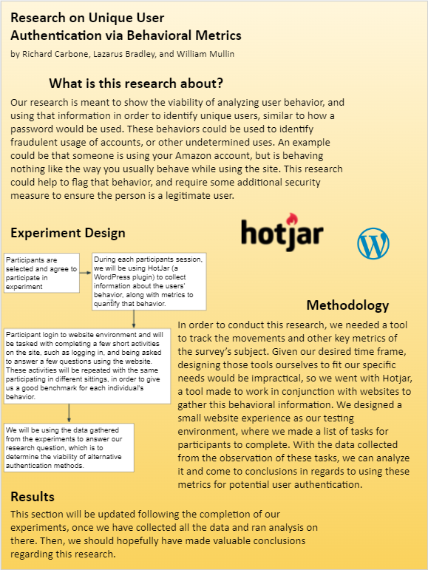
Poster

Slide 9
What else needs to be done
Basically, the only thing that needs to be done is to run the experiments - which should take relatively little time - and then analyze our data and come to conclusions on it.
We plan to have the experiments completed and raw data collected before Thanksgiving break, so that we will have time to analyze it before the deadline.

Slide 10
Thank you

